Slide 1
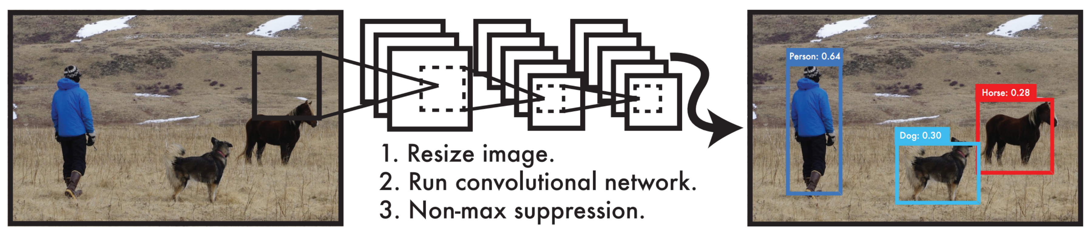
Object Detection - YOLO
Literature Sharing: Xiaokang Guo
Notes:
In I will cover the architecture of YOLO model version 1 but allow me first briefly introduce other object detection models mentioned in the paper I sent you.

Slide 2
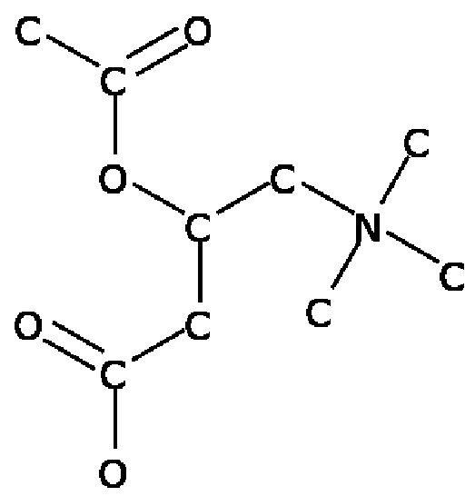
Term Project
Get SMILES
C-C(=O)-O-C(-C-C(=O)-O)-C-N(-C)(-C)-C
Presence of Atom → Character
Atom Type → C, N, O, S, …
Presence of Bond → Symbol
Bond Type → = or #
Notes:
Motivation of this sharing

Slide 3
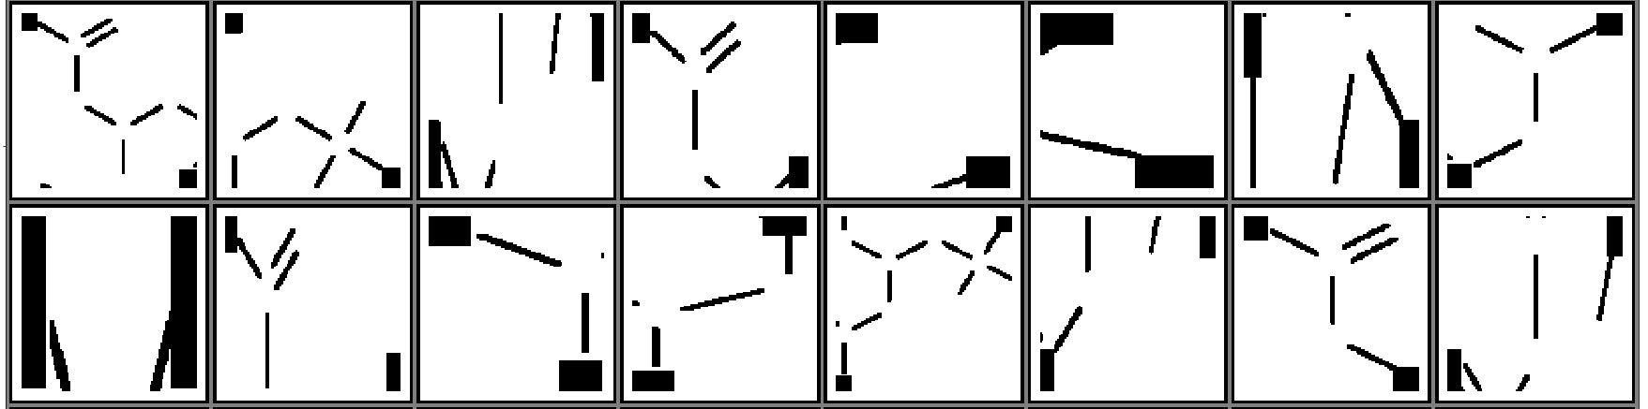
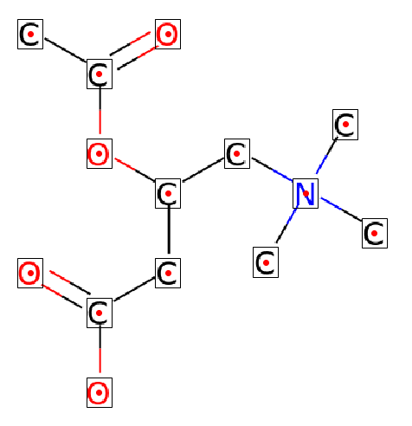
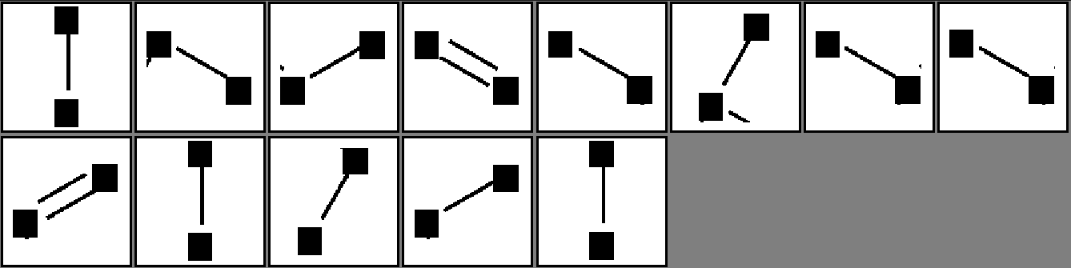
Term Project
Presence of Atom
Atom Type
Presence of Bond
Bond Type
Unbonded
Sliding
Window
C
O
C
C
O
C
C
N
C
Bonded
C
O
C
C
O

Slide 4
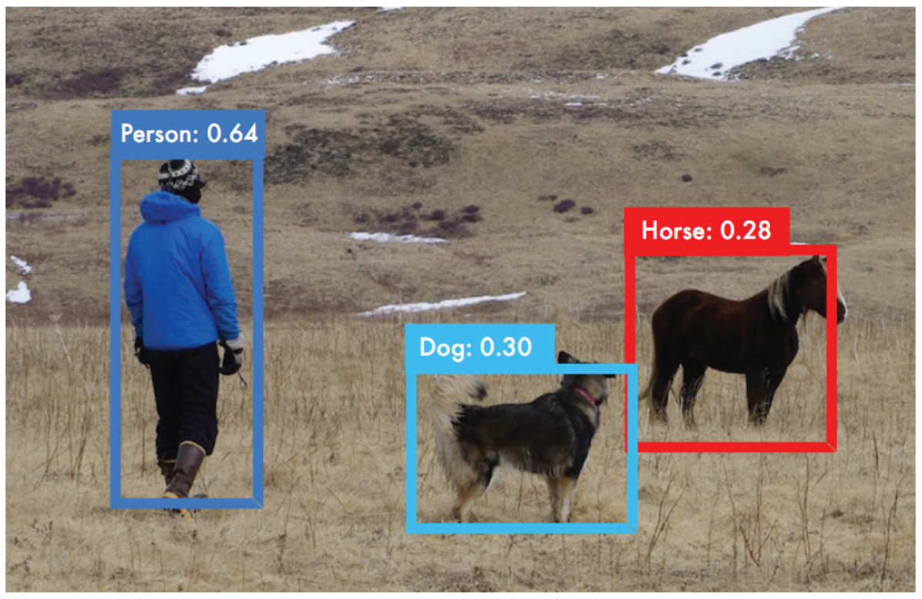
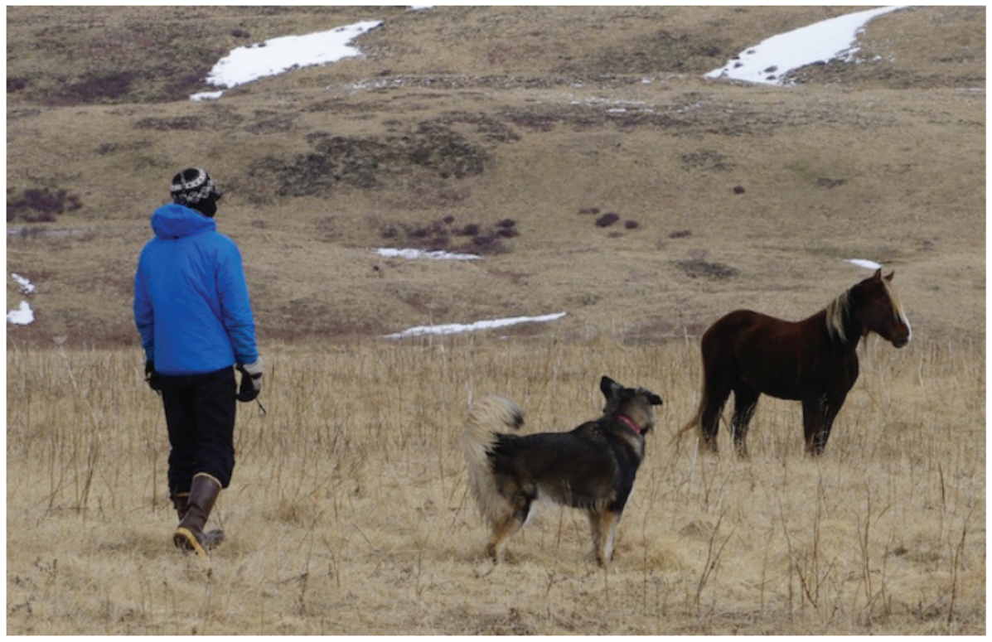
Capability of Object Detector
Add bounding box and class identifier simultaneously
C
O
C
C
O
C
C
N
C
O
C
C
C
O

Slide 5
You Only Look Once Version 1
Fast end-to-end CNN
Fast enough for real-time detection
One shot object detector
Other mentioned models ?
Region CNN
Fast R-CNN
Faster R-CNN

Slide 6
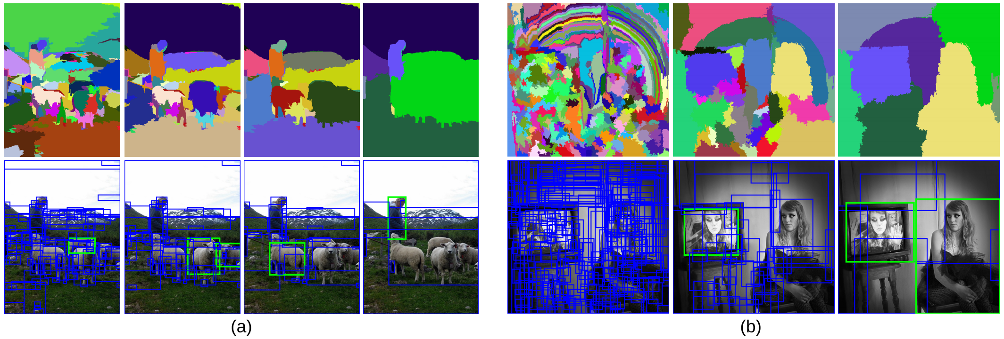
Region Proposal
Selective Search (SS): 1. Generate initial sub-segmentation, we generate many candidate regions 2. Use greedy algorithm to recursively combine similar regions into larger ones 3. Use the generated regions to produce the final candidate region proposals
Notes:
classifier

Slide 7
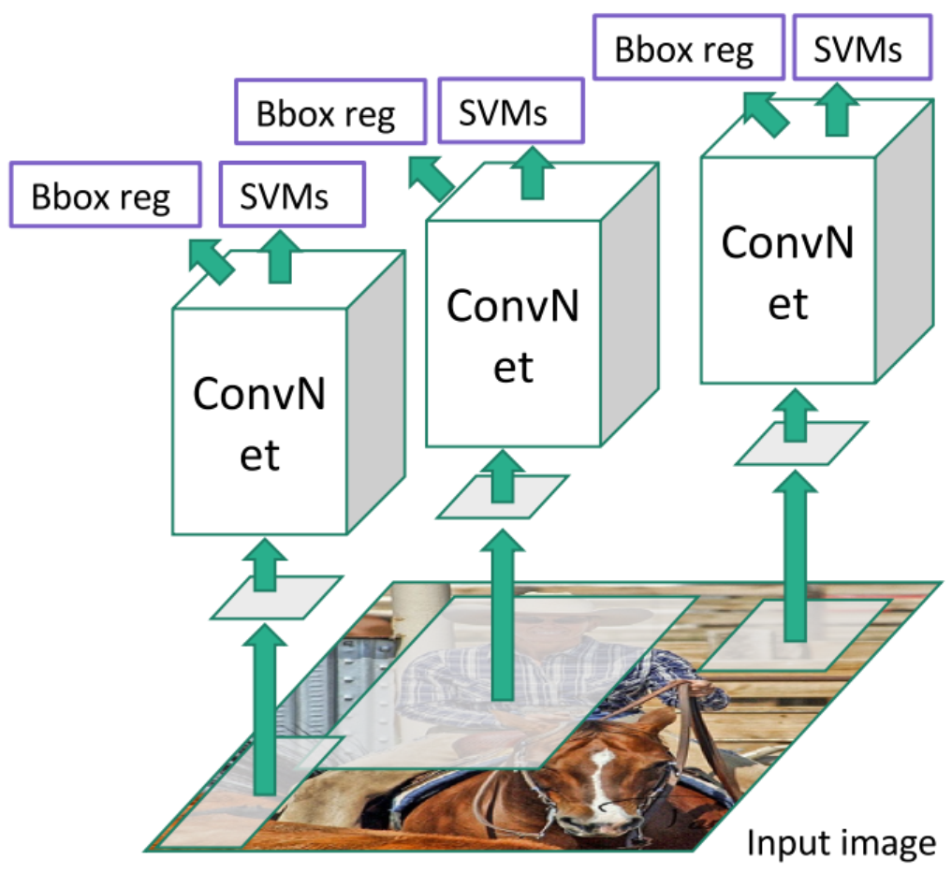
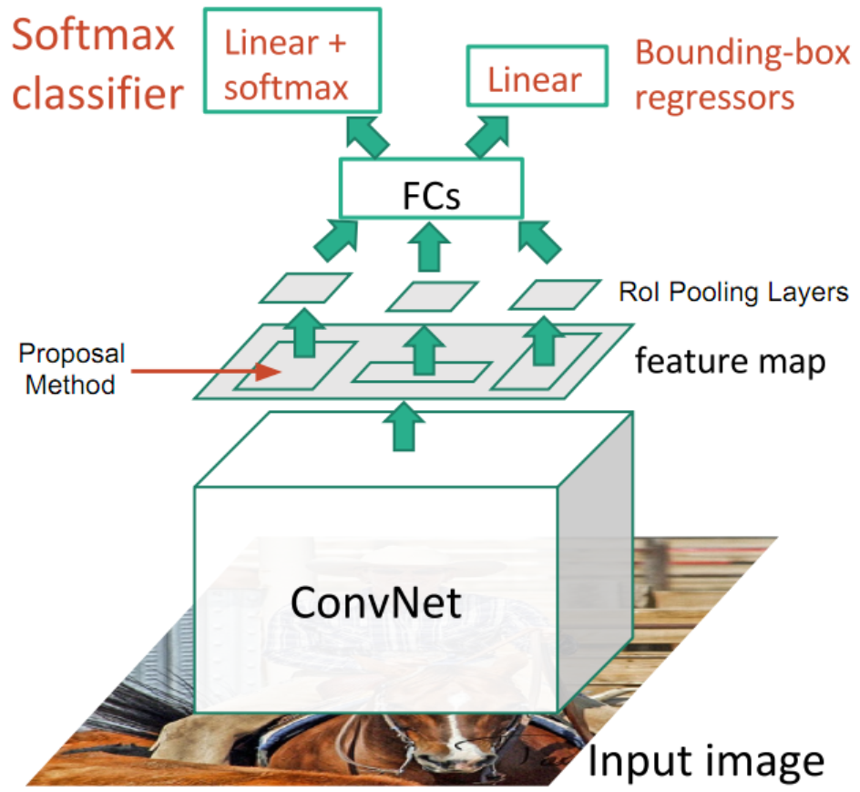
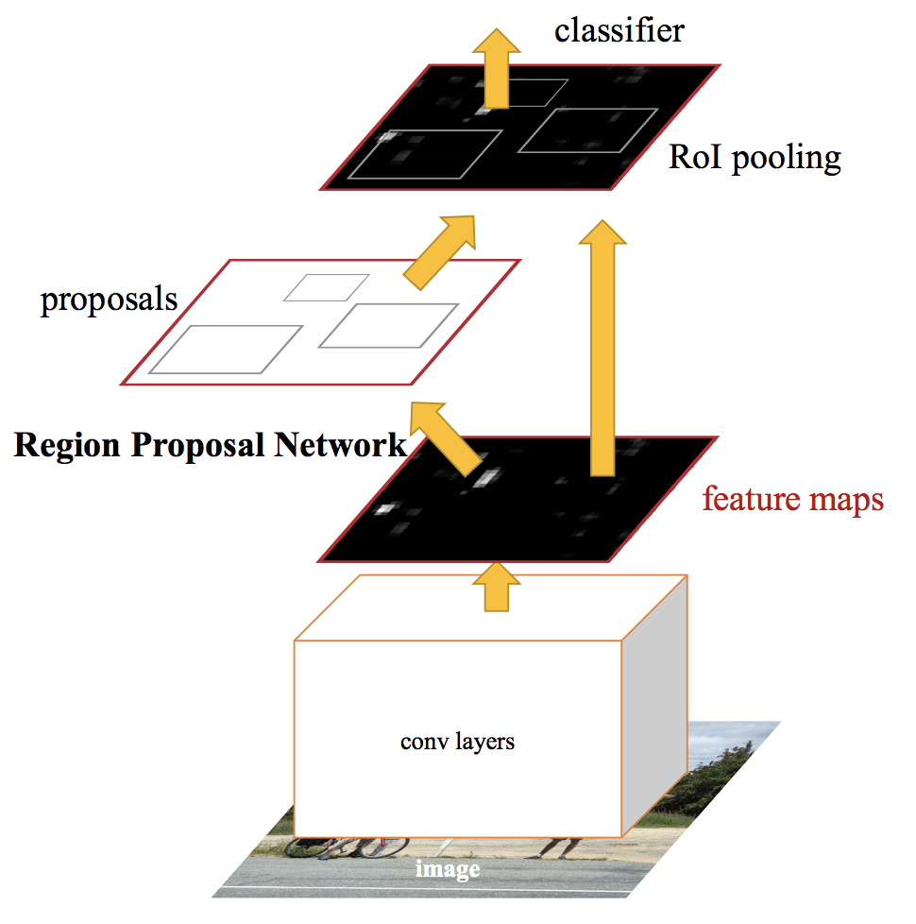
R-CNN / Fast R-CNN / Faster R-CNN
Image → SS → Region Proposal (2k) → CNN → Features → SVM → Objectness
47s / image with VGG16 [Simonyan & Zisserman. ICLR15]
Image → ConvL → Features → SS → Proposal → RoI Pooling → FCL → Result
Around 1 second per image
Proposal Method Region Proposal Network

Slide 8
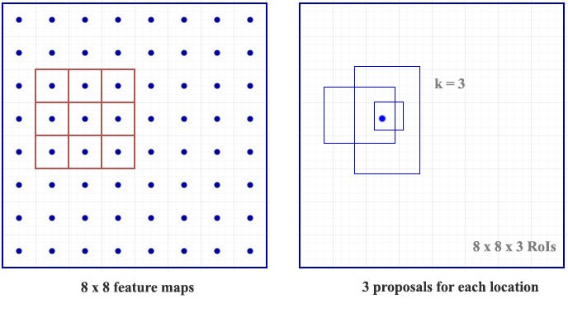
Region Proposal Network

Slide 9
You Only Look Once
Arbitrary Size

Slide 10
You Only Look Once
Fixed Size (448px×448px)

Slide 11
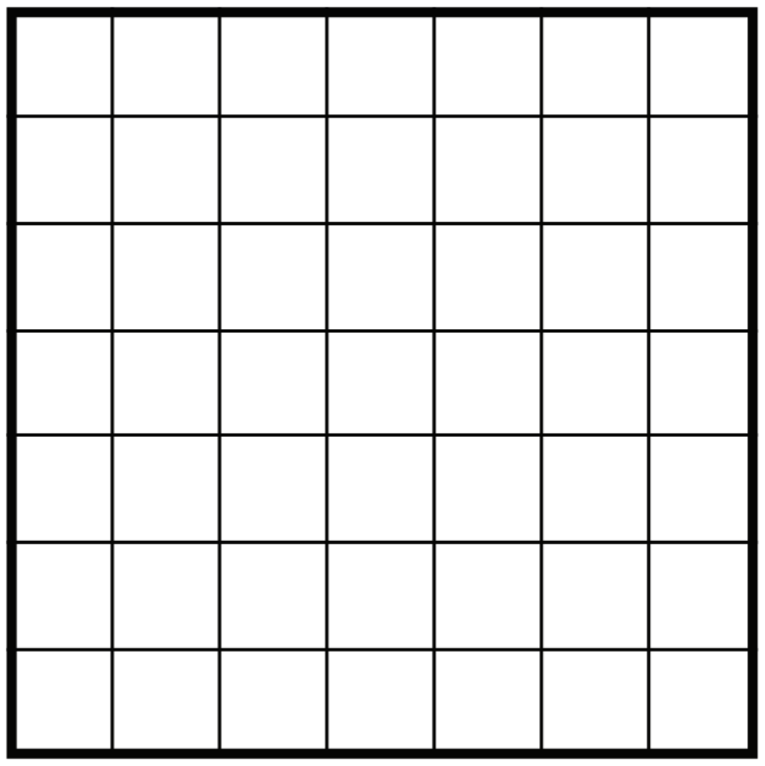
Capability
Localized detector which might be responsible for the whole image

Slide 12
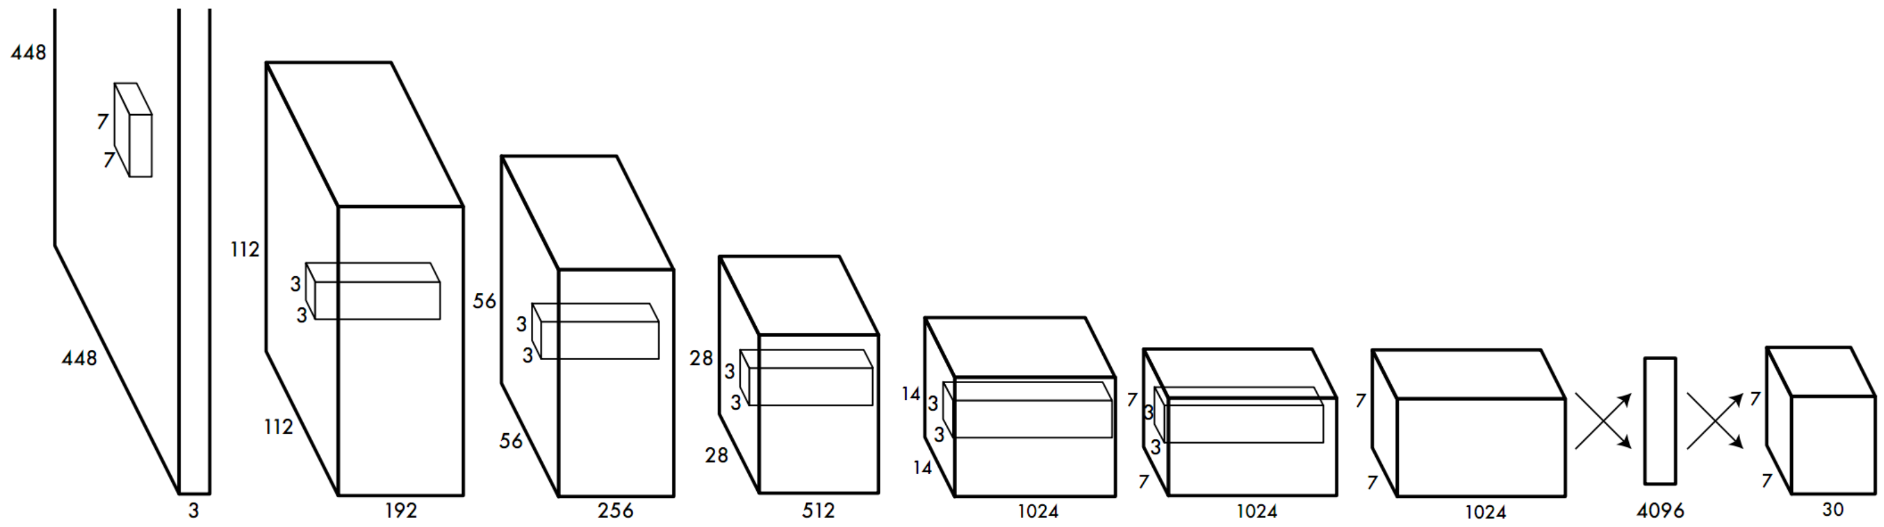
Architecture of YOLOv1
 | Conv 1 | Max Pool 1 | Conv 2 | Max Pool 2
Filters | (7,7,64,2) | (2,2,2) | (3,3,192) | (2,2,2)
Output | 224×224×64 | 112×112×64 | 112×112×192 | 56×56×192
Conv 3 | Conv 4 | Conv 5 | Conv 6 | Max Pool 3
(1,1,128) | (3,3,256) | (1,1,256) | (1,1,512) | (2,2,2)
56×56×128 | 56×56×256 | 56×56×256 | 56×56×512 | 28×28×512
 | C7 | C8 | C9 | C10 | C11 | C12 | C13 | C14 | C15 | C16 | P4
Filters | (1,1,256) | (3,3,512) | (1,1,256) | (3,3,512) | (1,1,256) | (3,3,512) | (1,1,256) | (3,3,512) | (1,1,512) | (3,3,1024) | (2,2,2)
Output | 28×28×256 | 28×28×512 | 28×28×256 | 28×28×512 | 28×28×256 | 28×28×512 | 28×28×256 | 28×28×512 | 28×28×512 | 28×28×1024 | 14×14×1024
 | C17 | C18 | C19 | C20 | C21 | C22 | C23 | C24 | F1
Filters | (1,1,512) | (3,3,1024) | (1,1,512) | (3,3,1024) | (3,3,1024) | (3,3,1024,2) | (3,3,1024) | (3,3,1024) | -
Output | 14×14×512 | 14×14×1024 | 14×14×512 | 14×14×1024 | 14×14×1024 | 7×7×1024 | 7×7×1024 | 7×7×1024 | 4096
F2
-
7×7×30

Slide 13
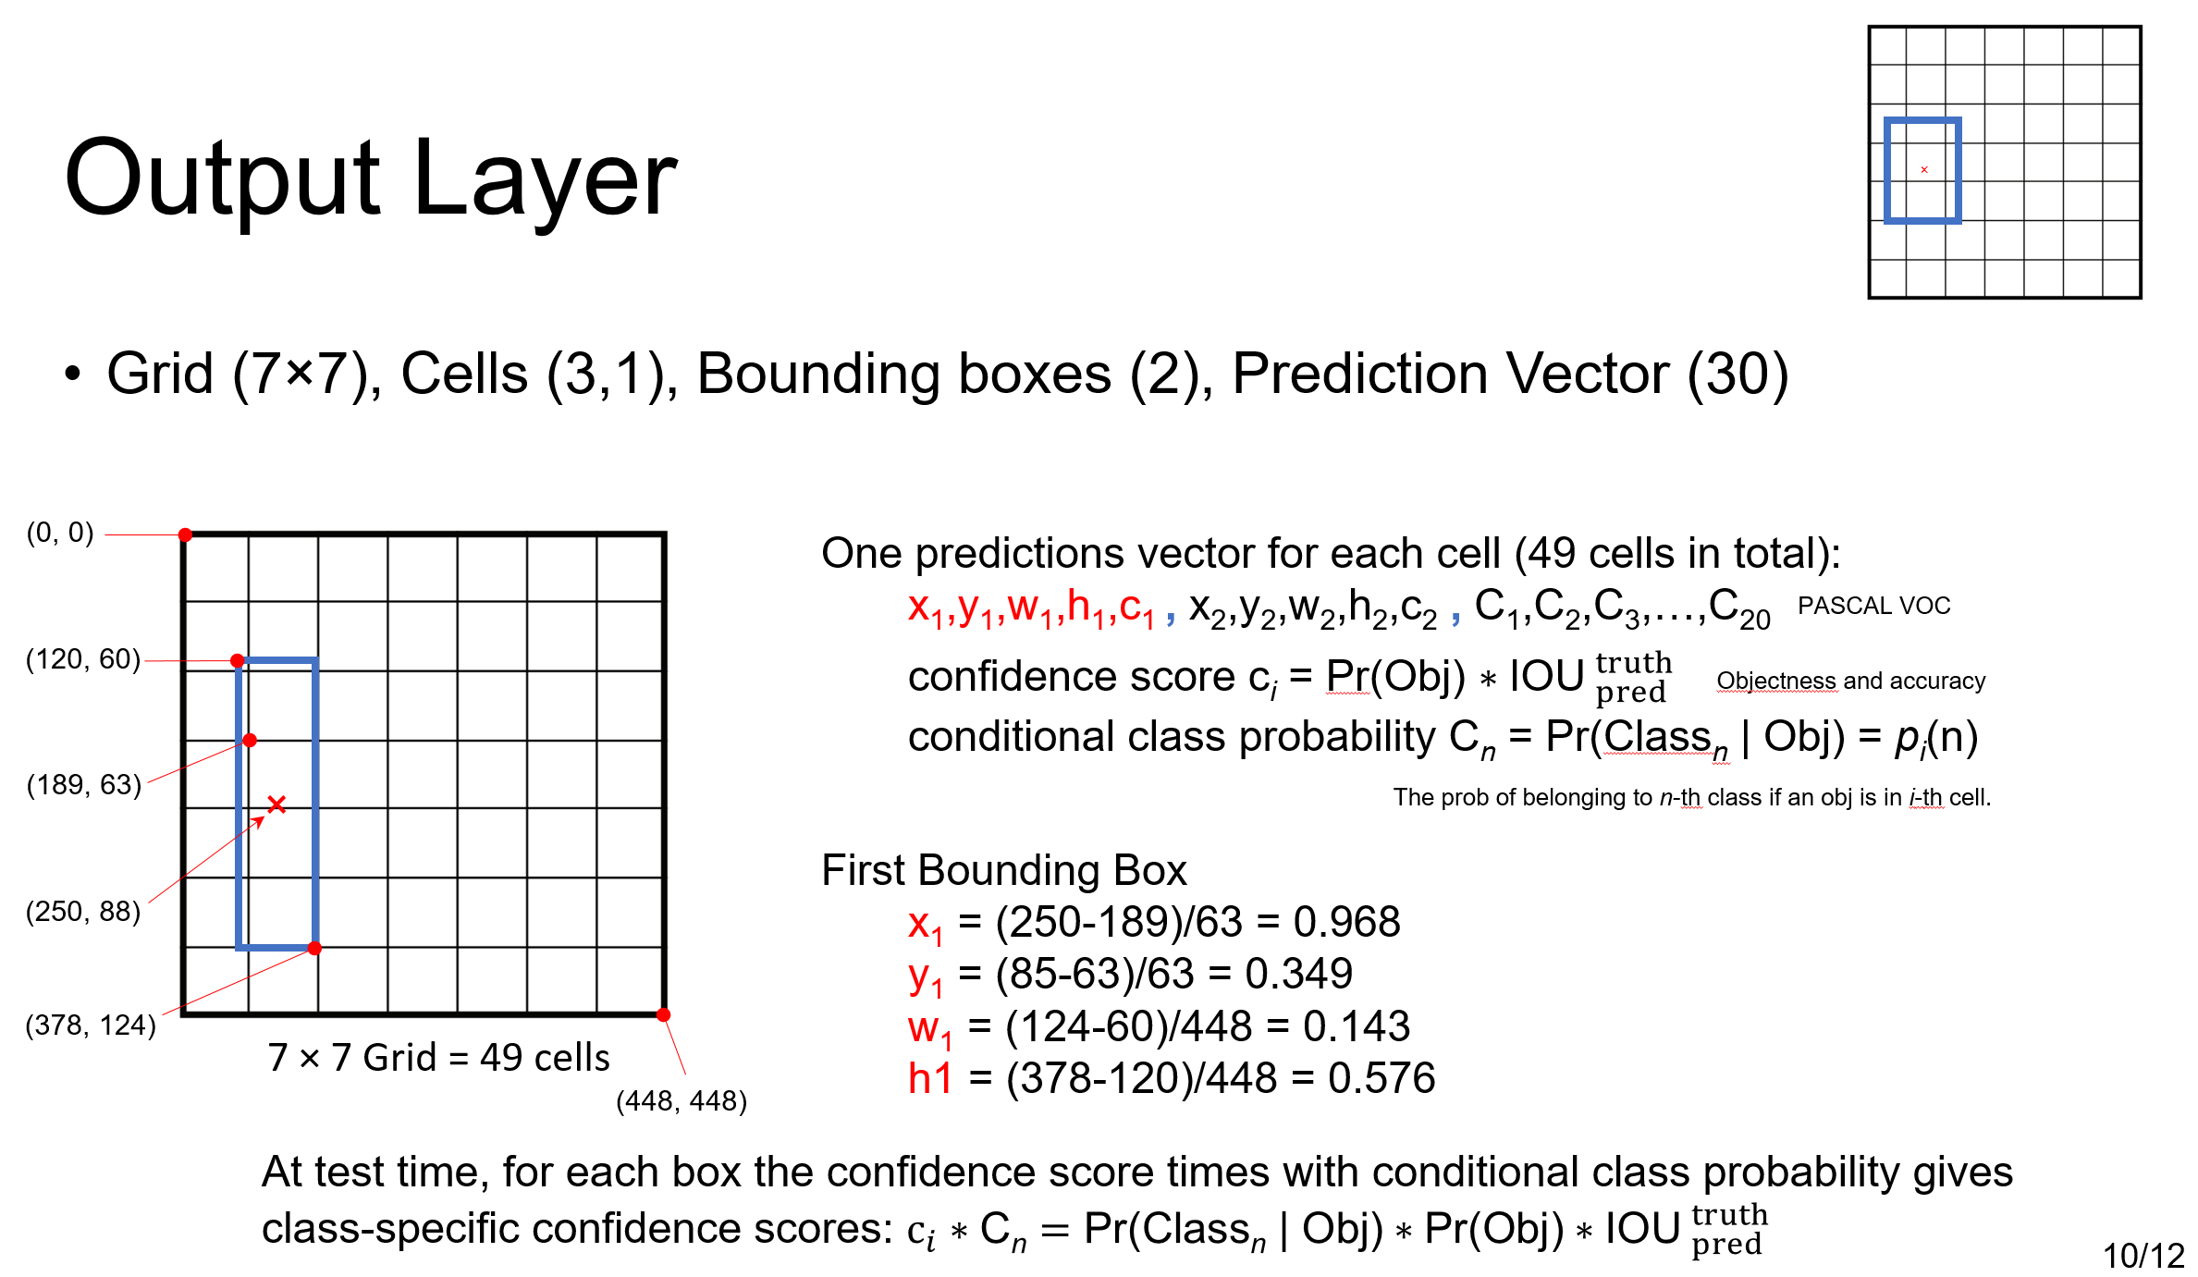
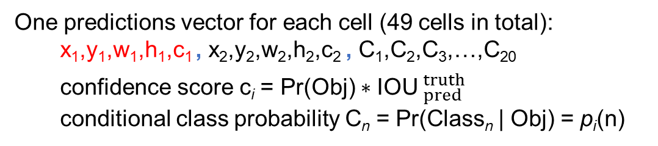
Output Layer
×
Grid (7×7), Cells (3,1), Bounding boxes (2), Prediction Vector (30)
(0, 0)
One predictions vector for each cell (49 cells in total):
x₁,y₁,w₁,h₁,c₁ , x₂,y₂,w₂,h₂,c₂ , C₁,C₂,C₃,…,C₂₀
confidence score c_{i} = Pr(Obj) $∗$IOU$._{pred}^{truth}$
conditional class probability C_{n} = Pr(Class_{n} | Obj) = p_{i}(n)
PASCAL VOC
(120, 60)
Objectness and accuracy
(189, 63)
×
The prob of belonging to n-th class if an obj is in i-th cell.
First Bounding Box
x₁ = (250-189)/63 = 0.968
y₁ = (85-63)/63 = 0.349
w₁ = (124-60)/448 = 0.143
h1 = (378-120)/448 = 0.576
(250, 88)
(378, 124)
7 × 7 Grid = 49 cells
(448, 448)
At test time, for each box the confidence score times with conditional class probability gives
class-specific confidence scores: $c_{i}∗\text{C}\text{n}=\text{Pr}\text{(}\text{Class}\text{n}\text{ | }\text{Obj}\text{)}∗\text{Pr}\text{(}\text{Obj}\text{)}∗\text{IOU}._{pred}^{truth}$

Slide 14
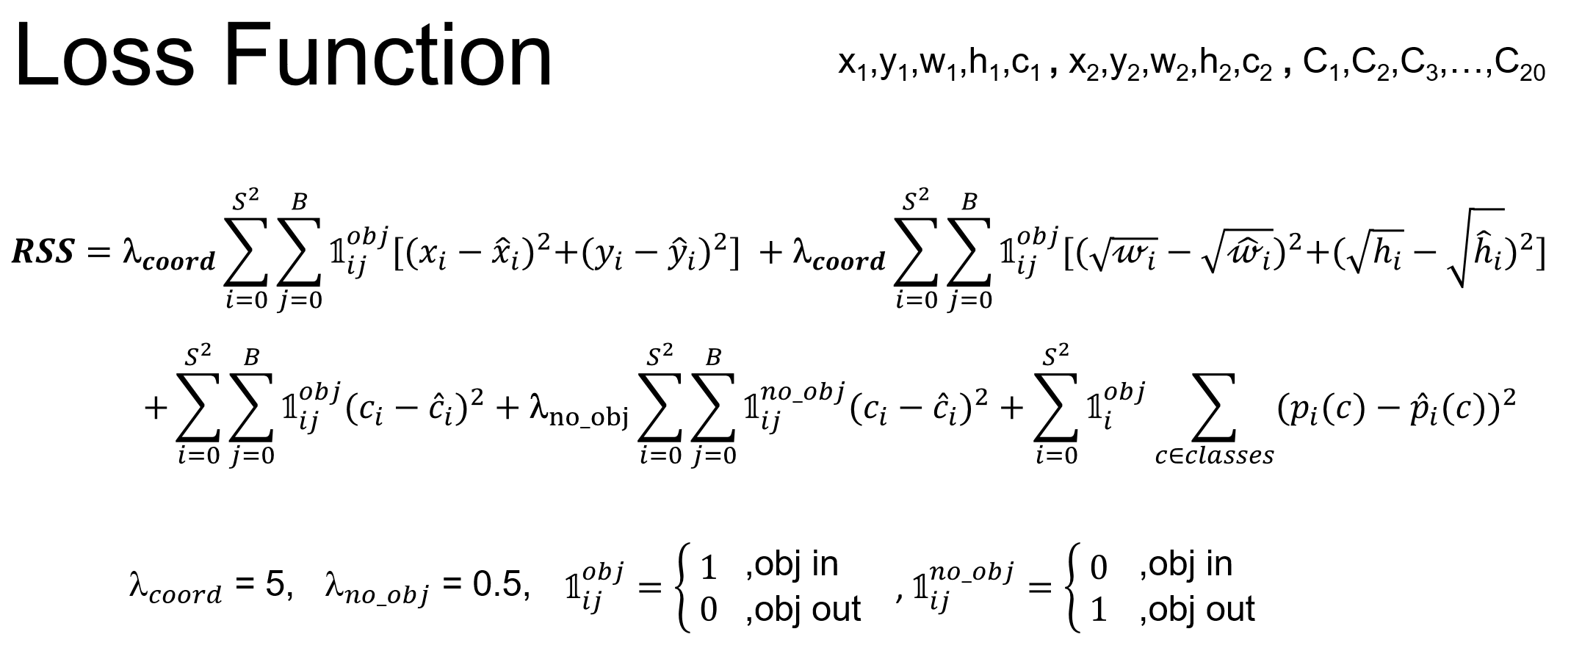
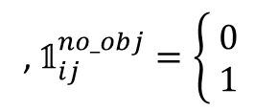
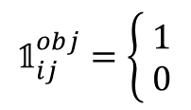
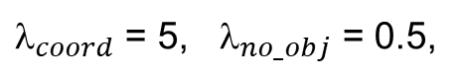
Loss Function
x₁,y₁,w₁,h₁,c₁ , x₂,y₂,w₂,h₂,c₂ , C₁,C₂,C₃,…,C₂₀
$$RSS={\text{l}}_{coord}\sum_{i=0}^{S^{2}}{\sum_{j=0}^{B}{𝟙_{ij}^{obj}[{(x_{i}−{\hat{x}}_{i})}^{2}+{(y_{i}−{\hat{y}}_{i})}^{2}] }}+{\text{l}}_{coord}\sum_{i=0}^{S^{2}}{\sum_{j=0}^{B}{𝟙_{ij}^{obj}[{(\sqrt{𝓌_{i}}−\sqrt{{\hat{𝓌}}_{i}})}^{2}+{(\sqrt{h_{i}}−\sqrt{{\hat{h}}_{i}})}^{2}] }}$$
$$+\sum_{i=0}^{S^{2}}{\sum_{j=0}^{B}{𝟙_{ij}^{obj}{(c_{i}−{\hat{c}}_{i})}^{2}}}+{\text{l}}_{no_obj}\sum_{i=0}^{S^{2}}{\sum_{j=0}^{B}{𝟙_{ij}^{no_obj}{(c_{i}−{\hat{c}}_{i})}^{2}}}+\sum_{i=0}^{S^{2}}{𝟙_{i}^{obj}\sum_{c∈classes}{{(p_{i}(c)−{\hat{p}}_{i}(c))}^{2}}}$$
$$𝟙_{ij}^{obj}=\left\{\begin{aligned} 1 \\ 0\end{aligned}\right.$$
,obj in
, $𝟙_{ij}^{no_obj}=\left\{\begin{aligned} 0 \\ 1\end{aligned}\right.$
,obj in
${\text{l}}_{coord}$ = 5, ${\text{l}}_{no_obj}$ = 0.5,
,obj out
,obj out

Slide 15
References
YOLO v1 Original Paper
https://arxiv.org/abs/1506.02640
Understanding YOLO
https://hackernoon.com/understanding-yolo-f5a74bbc7967
Selective Search
https://www.koen.me/research/pub/uijlings-ijcv2013-draft.pdf
R-CNN, Fast R-CNN, Faster R-CNN, YOLO – Object Detection Algorithm
https://towardsdatascience.com/r-cnn-fast-r-cnn-faster-r-cnn-yolo-object-detection-algorithms-36d53571365e
RPN
https://medium.com/@jonathan_hui/what-do-we-learn-from-region-based-object-detectors-faster-r-cnn-r-fcn-fpn-7e354377a7c9
F.F. Li et., CS231n, Lecture 11, Stanford, 2017
http://cs231n.stanford.edu/slides/2017/cs231n_2017_lecture11.pdf

Slide 16
Thanks for your attention!

Slide 17
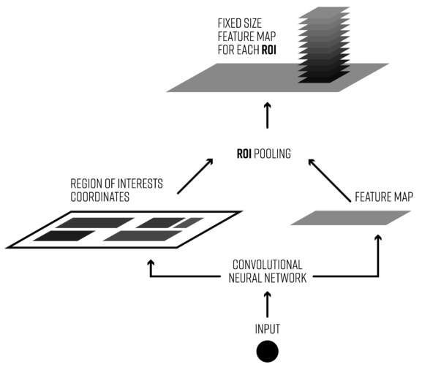
RoI Pooling in Fast R-CNN
https://deepsense.ai/region-of-interest-pooling-explained/

Slide 18
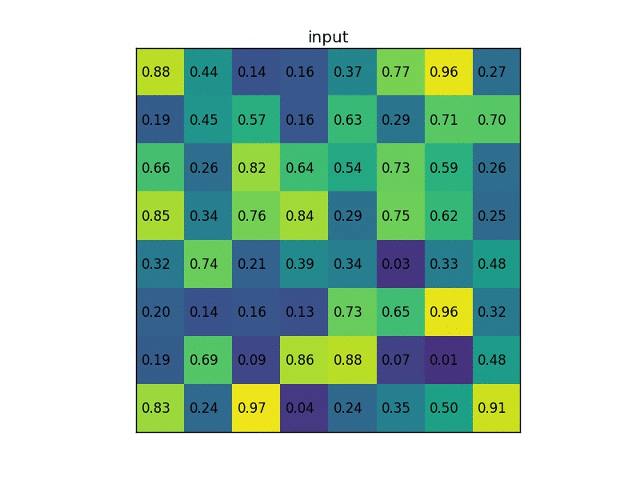

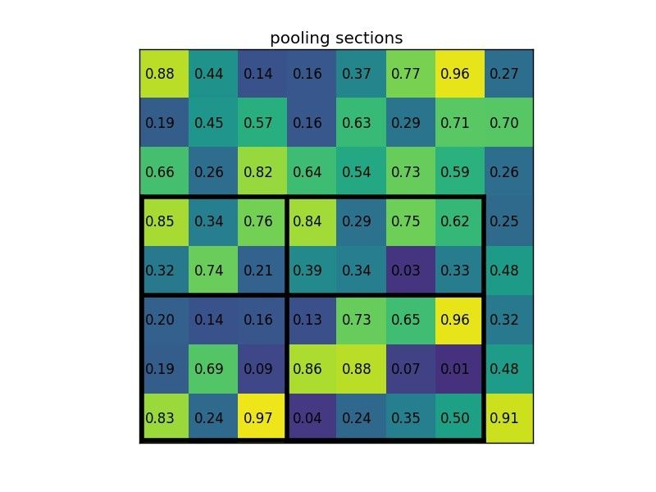
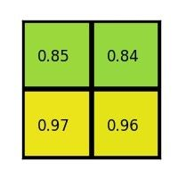
Region of Interest Pooling Layer
https://deepsense.ai/region-of-interest-pooling-explained/

Slide 19
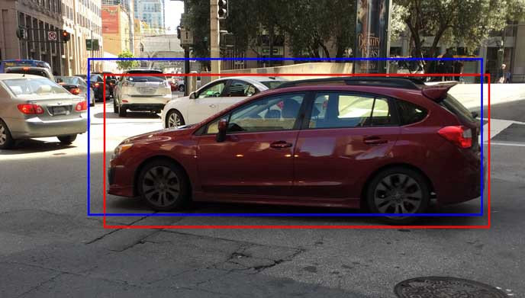
BBox Regressor
Use regression to refine the original ROI in blue to the red one
https://medium.com/@jonathan_hui/what-do-we-learn-from-region-based-object-detectors-faster-r-cnn-r-fcn-fpn-7e354377a7c9

Slide 20

Intersection over union
Predicted
bounding
box
ground
truth
bounding
box
https://www.pyimagesearch.com/2016/11/07/intersection-over-union-iou-for-object-detection/

Slide 21
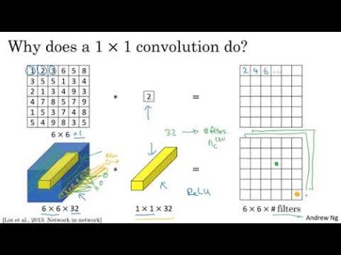
1×1 Convolutional Layer
Andrew Ng
https://www.youtube.com/watch?v=vcp0XvDAX68

Slide 22
Train Strategy
The authors describe the training in the following way
First, pretrain the first 20 convolutional layers using the ImageNet 1000-class competition dataset, using a input size of 224x224
Then, increase the input resolution to 448x448
Train the full network for about 135 epochs using a batch size of 64, momentum of 0.9 and decay of 0.0005
Learning rate schedule: for the first epochs, the learning rate was slowly raised from 0.001 to 0.01. Train for about 75 epochs and then start decreasing it.
Use data augmentation with random scaling and translations, and randomly adjusting exposure and saturation.

